Slide 1
St Peter’s Church, Winchcombe
Integrated Project (IP)
Brief to Parish
6 & 17 Aug 25

Slide 2
Introduction
Revd David Penny

Slide 3
Parish IP Team
Revd David Penny
Simon Andrews
Sue Proctor
Heating, Solar/Power, Seating
  Tim Hall
  Alan Thomas
  Peter Methven
Lighting & Audio-visual
  Rob Davies
  Sue Crownshaw
  Mark Collins
Independent Space
  Geof Adlington
  Tony Mason

Slide 4
Bottom Line Up Front
Options
Vision
  West end two floor independent enclosed space:
    Meeting spaces.
    Catering facility.
    Two loos.
    Mezzanine.
  Wider building heating, seating, lighting, audio-visual(AV) solution.
Pragmatic
  Lady Chapel independent enclosed space.
  Wider building heating.
  Develop costings for seating, lighting and AV but execution on hold until funds identified.

Slide 5
Background
Largest public building in the town.
Building’s primary (but not sole) purpose: provide a place of worship for the community.
Currently not fit for mission, ministry or community activity in the 21st Century.
  Temperature.
  Seating constraints.
  Inflexible lighting.
  Inadequate AV system.
  No effective meeting spaces: youth and community.

Slide 6
Principles
Saving Heritage:
  Opportunity to better present the building's heritage.
  Building’s evolving shape.
Protecting the Environment:
  Moving away from gas fired heating.
  Lighting more economic and environmentally neutral solution.
  Solar panel system.
  Power storage.
Inclusion, Access and Participation:
  To welcome the wider community and congregations of the future:
    Make the space more welcoming, comfortable and warmer.
    Improve the flexibility of the space.
    Reduce the formality of the space.
    Simplify the creation of occasional spaces.
  Current congregation and users.
  Visitor numbers.
  Expansion of other users.

Slide 7
This Building has Never Stood Still (Hide)
1982: Font moved from Nave to SW aisle.
1984: Bell tower ringing chamber built and glazed.
1984: Rood screen moved from Chancel to West Nave.
2004/6: Interior porch lobby & Choir Vestry cupboards built.
2011: Solar panels installed on South Aisle roof.
2012: Electrical meters cupboard built.
2015: New flooring and chairs put in place in West Nave.
2017: Disabled toilet in bell tower.

Slide 8
Endstate (PCC Approved)
Noting the Diocese’s net zero 2030 target, a church building fit for purpose to serve the demands of a modern congregation and community in terms of heating, lighting, seating and audio-visual support, and the provision of an independent space for the engagement of younger congregants within services and wider community users without.

Slide 9
Possible Phasing of Activity
Phase 1a: the provision of a multi-functional, independent space noting the need for soundproofing, heat retention, and suitable lighting for both the space and integration with solutions (below) for the wider church space.
Phase 1b: whilst our gas boiler is still working, the future provision of a heating solution that heats people rather than the building. Our research so far shows the need for a hybrid solution, likely electrically based. It is appreciated that any desired seating solution (pews/seats) would dictate some heating solutions being unviable. Review our solar panels strategy for the provision of energy.
Phase 2a: develop seating solutions. Noting there are heating solutions that are able to also provide lighting, we would seek to provide a new system that is more energy efficient than the current one which can either be part of a heating solution or separate.
Phase 2b: the upgrading of our current audio-visual provision including the removal of older evolutionary installed cabling and infrastructure but taking advantage of electrical ducting that the heating and lighting solution may offer.

Slide 10
Factors
Costs:
  Development funds (pre-Faculty) for “Vision” solution possibly £50k+.
  Sources for pre-Faculty funding limited.
  National Lottery Heritage Fund advice.
Independent space:
  Development of younger family environment (and community space).
  Possible ‘quick win’.
Contingency for boiler failure.
Phasing based on funding availability.

Slide 11
Independent Space
Options
  Lady Chapel
  West end

Slide 12
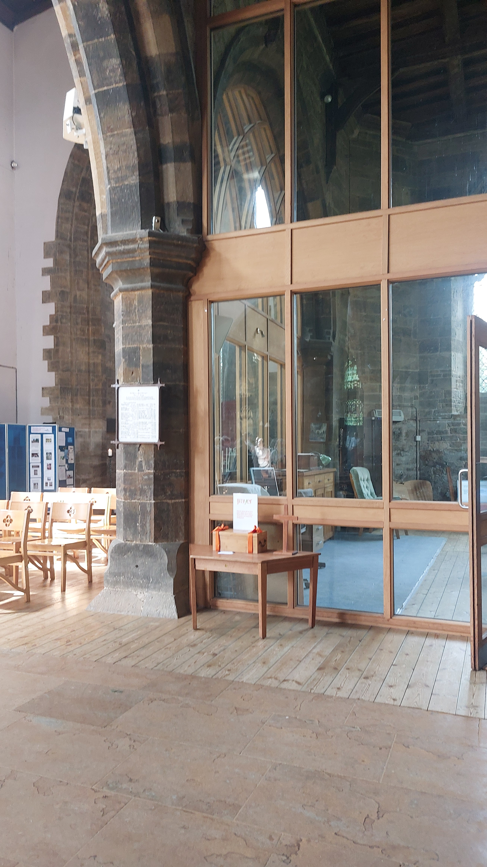
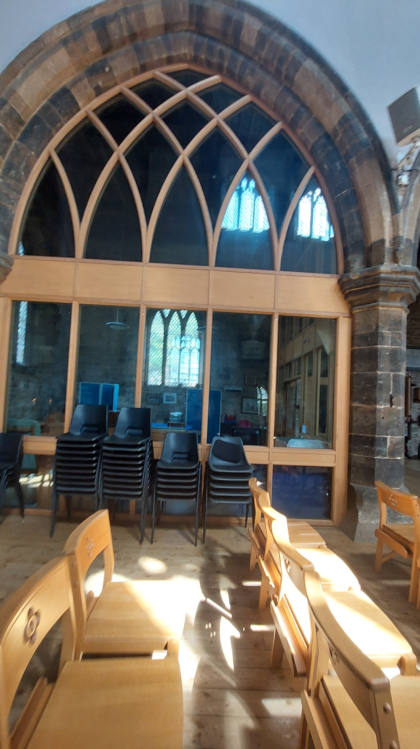
Lady Chapel
(Enclosed Option)
Deddington Church, Oxon

Slide 13
West End
PCC’s Essentials, Desirables and Nice to Haves
Essential
Rood screen moved East.
Two loos including disabled/baby change.
Storage.
Secondary glazing.
AV hub space identified.
Catering facility.
Choir Vestry.
Desirable
Font relocation.
Mezzanine.
Lift.
First floor secondary emergency access.
Folding doors in the ground floor independent space.
SW aisle area use?
Enclosed space above NW ground floor Choir Vestry.
Nice to Have
Folding doors in catering hatch.

Slide 14
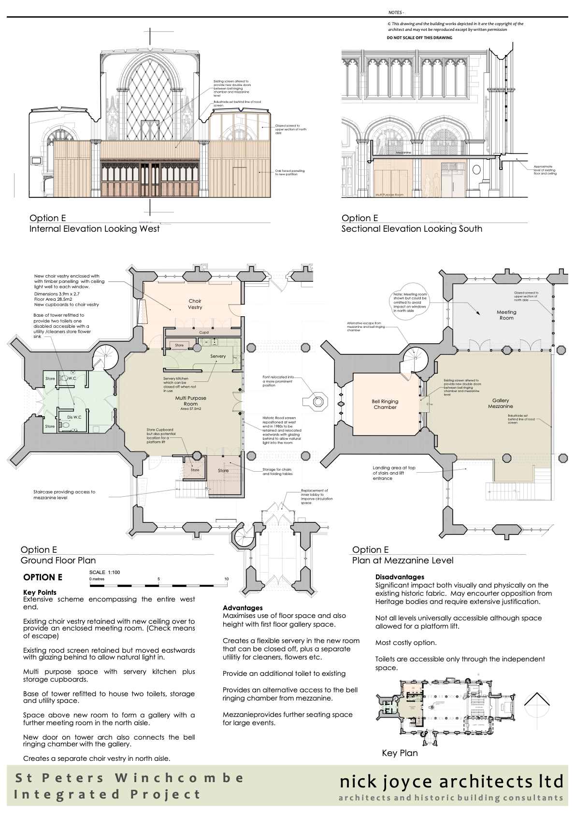
West End Option
Double Floor
Entire West end.
Servery kitchen.
Choir Vestry with ceiling.
Existing rood screen moved East.
Two toilets.
Storage.
Mezzanine gallery.
Meeting room above Choir Vestry.
Connecting door between bell ringing chamber and gallery (2nd emergency escape).
Welcoming area and restructuring of inner lobby entrance.
Font relocation tbc in Nave.
AV desk location in structure (not mobile).
Secondary glazing.

Slide 15
Description of Project Elements
Heating, Solar Panels/Power.
Seating.
Lighting & Audio-visual (AV).

Slide 16
Heating and Solar Panels/Power
Move away from gas.
Solar panels and batteries.
Relative energy costs.

Slide 17
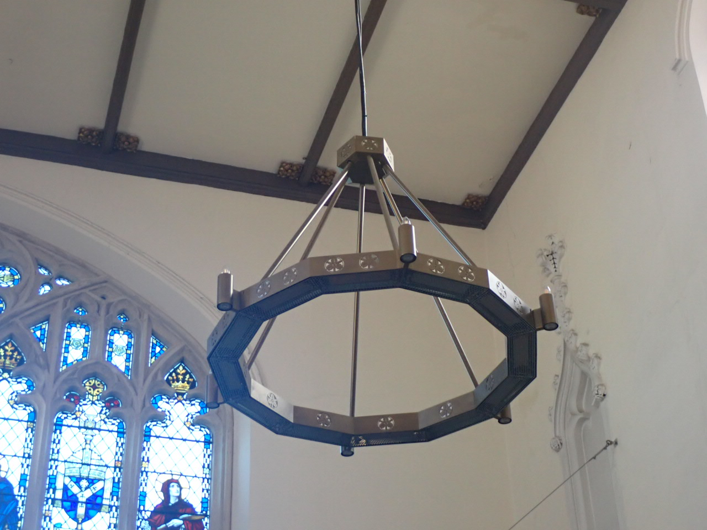
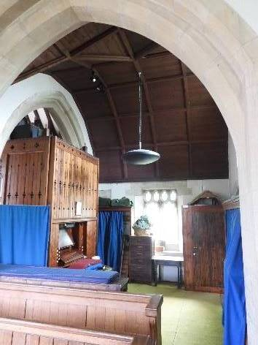
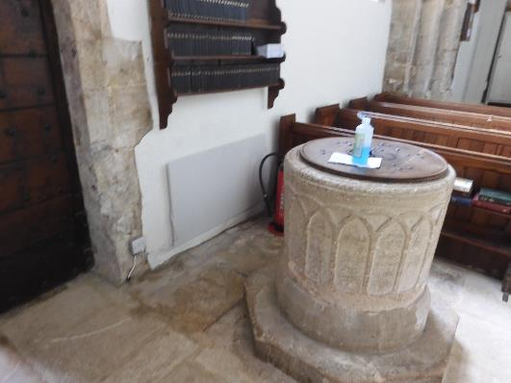
Heating Proposals
Replace gas boiler.
Radiant chandelier.
Radiant panels.
Individual seat heating.
Underfloor heating.
Under pew fixed fan heaters.
Heat Pumps.

Slide 18
Power Proposals
Batteries.
Considerable capital cost.
Heat Pump Solution: second battery set.
Additional solar panels.

Slide 19
Seating Proposals
Bench options (2-5 people).
Folding/stacking.
Lady Chapel unchanged.
Aisle pew refurbishment.

Slide 20
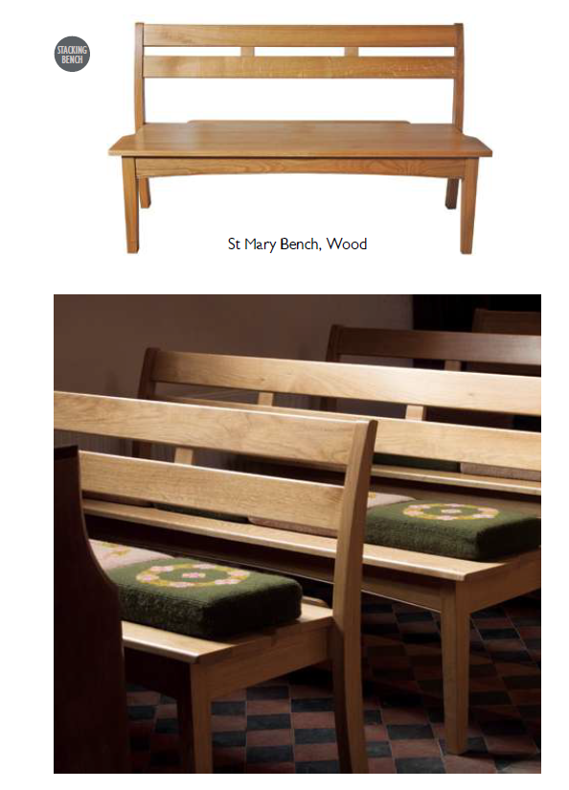
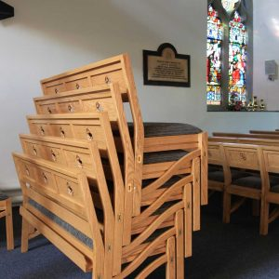
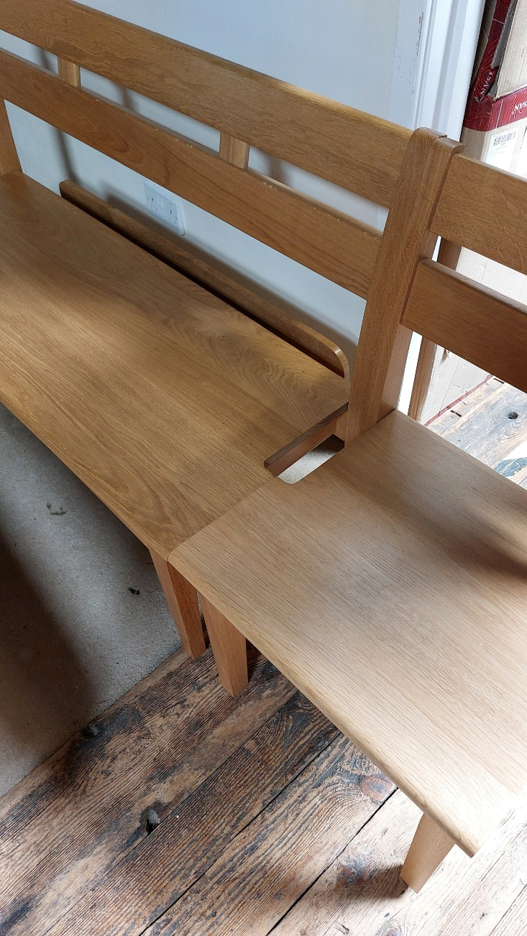
Seating (Stackable)
Treske Bench Link Details

Slide 21
Lighting Proposals
Current
  Main lighting is inflexible.
  The overall light level only adequate.
  Chandelier lighting access
  LED enclosures less intrusive and power saving.
Future
  Supporting special services and events.
  Link lighting with AV provision.
  Link lighting with heating solutions.

Slide 22
Audio-visual (AV) Current
Current system was for a past need.
AV accessed and controlled from separate locations.
Lectern and pulpit microphones require speaking into.
Lapel microphones limitations.
Limited visual capability.
Livestreaming.

Slide 23
AV Proposals
TV monitor screens:
      Flexibility for services (visual aids) and hymns.
      Accessibility for the non-churched or non-book culture.
      Environmentally friendly.
Enhance visitor experience.
Flexibility for other users.
Better accessibility for the hearing impaired.
Linking AV upgrade to the lighting/wiring element.
Summary
  One station AV desk.
  Screens throughout church.
  Mobile monitor stand(s).
  Lapel microphones upgrade.
  Lectern and pulpit double microphones.

Slide 24
Chicken and Egg Decision Making
Seating type impacts heating/lighting decisions.
Heating types impacts seating decisions.
Whatever decision: needs synergy between early development elements and longer timeline elements.

Slide 25
Miscellaneous Points
Secondary glazing.
Timeline.
Costs and Funding.
Likely contractors.
Consultation (DAC, English Heritage, Victorian Society etc).
Future of SPC?

Slide 26
Secondary Glazing
DAC approval?
Visit to Storm Windows.
Indicative costings:
  Glaze one window: £4,985.50 + VAT.
  Refurbishment of three windows every 5 years: £1,550 + VAT per visit.

Slide 27
Estimated Timeline
Autumn 2025: applications for development funding support?
Mid 2026 achieve DAC approval?
Late 2027/early 2028 start of building work?

Slide 28
Estimated Costs and Funding
Estimated full cost: £700k.
Listed Places of Worship Grant Scheme and VAT relief.
Grants pre-DAC Faculty Development costs.
Grants post DAC Faculty.
Friends of St Peter’s.
St Peter’s Centre Future?

Slide 29
Consultation
PCC
DAC
St Peter’s Congregation: the users
The wider church attending Parish
The wider users:
  Clubs and societies
  The town
Other space providers:
  Isbourne Centre
  Old School Buildings
Tewkesbury Borough Council (planning permission for external features)
English Heritage
Victorian Society
Who else?

Slide 30
Next Steps
Develop ideas based on feedback
Seek development grants
Initiate wider consultation
Develop brief for DAC Faculty
Continue to develop supporting infrastructure ideas
Develop costings

Slide 31
Questions

